Slide 1
A Cancer DB with AI pipelines for Professional Use (Can_Cer)
Leman Nur Nehri
METU Biological Sciences
Cancer Research & Computational Biology

Slide 2
Project summary:
Adapting the biological, chemical and pharmacological data of various cancer types to a single interface and producing solutions for the problems of experts working in cancer related fields.
This is a platform that keeps data such as mutagen-mutation, cancer-related diseases, host-factors, etc. for different cancer types in its own library and visualizes the required information by data extraction algorithms and artificial intelligence pipelines from this library to professional use for cancer research and clinical needs.

Slide 3
Aging is a complex process and many host factors are effective in the development and metastasis of cancer in the aging process. With computational biology approaches, it is possible to detect complex host factors,
&& and with personalized medicine, it is possible to detect these host factors & related key information individually and to develop treatments accordingly.

Slide 4
Host factors (Epidemiology) are known as intrinsic factor–age, race, sex, behaviors, etc. which influences an individual's exposure, susceptibility, or response to a causative agent (The free Dictionary, n.d.). Host factors alter the chemical pathways and microenvironments inside the body. These regulations influence internal biological processes and effects of evolutionary forces -such as natural selection- in tissue environments (Alberts et al., 2003).

Slide 5
Target Group Need Problem
Academics
Clinical doctors
Researchers
combining scientific expertise in different fields is difficult and costly
Cancer feeds from many different sources, especially in older people -host factors-
Patient-related problems: symptoms related to the drug used, predictability problem (drug-drug interactions & drug-patient interactions)
intersection point that includes all of these areas: collection & selection of current & dynamic scientific knowledge & integration into current situation (patient/diagnosis/treatment, etc.)

Slide 6
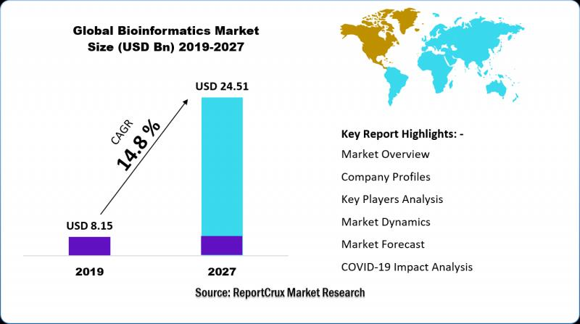
bioinformatics is a growing and sustainable industry

Slide 7
with this project:
Fast and reliable access to scientific information from different fields of expertise
making general theoretical knowledge applicable to the specific situation (e.g. the individual patient in the clinic)
Using each new patient follow-up record as training data with the help of artificial intelligence learning methods --> personalized insights for each patient
Accessibility as the library is available to everyone
Providing a scientific decision-support mechanism for the doctor with cost-benefit calculations

Slide 8
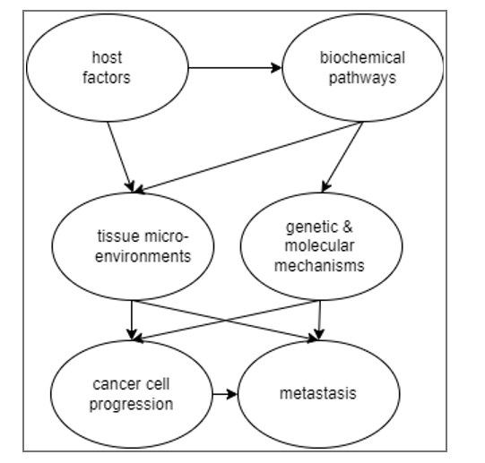
A Bayesian representation of the selected parameters for modeling the cancer progression and metastasis.

Slide 9
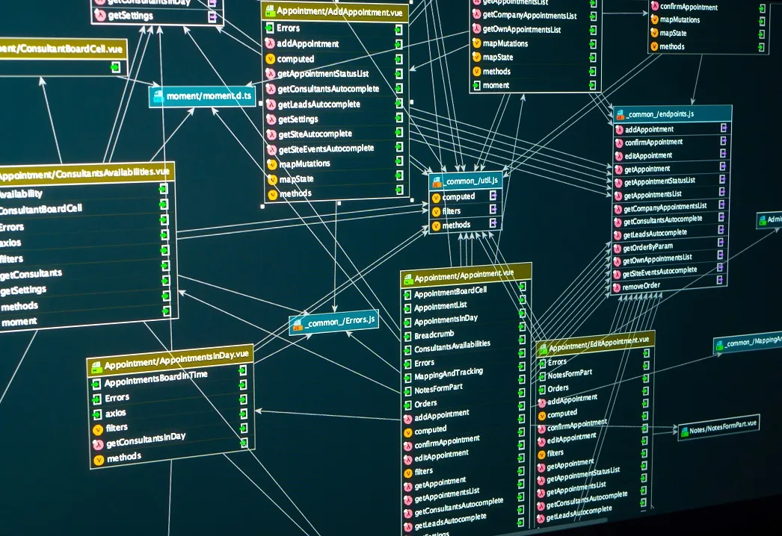
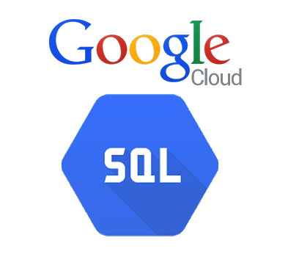

a database for every aspects of the cancer-aging relation - firebase for demo // google cloudsql for product

Slide 10
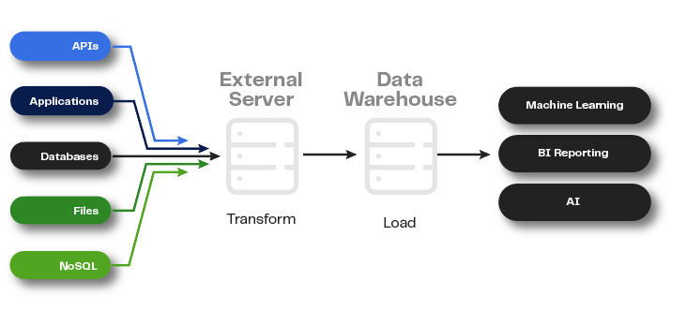
extract & process needed data

Slide 11

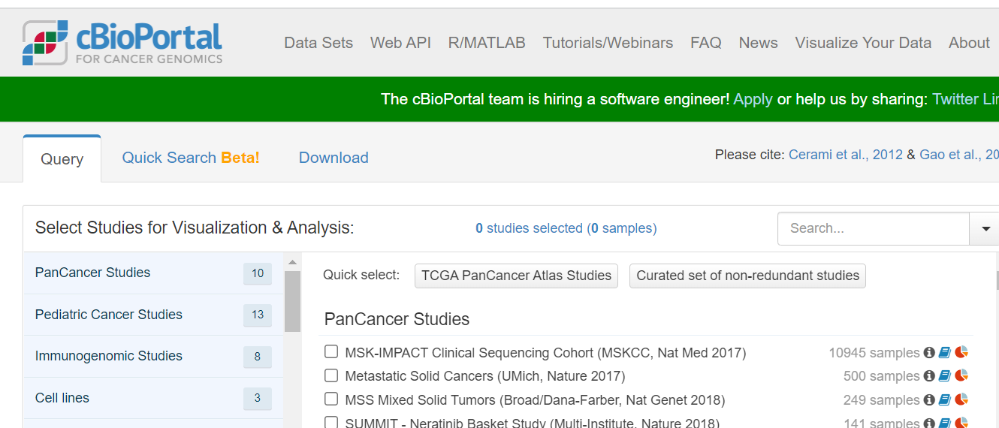
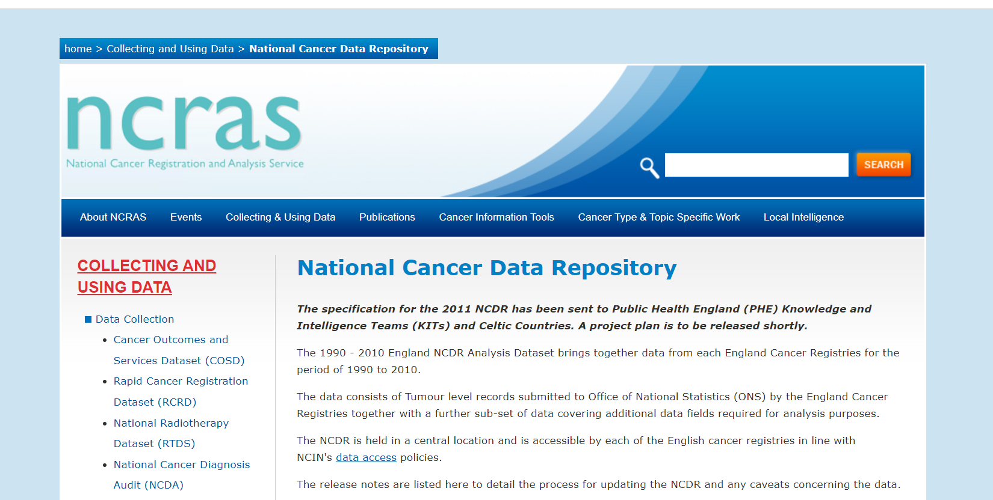
many db s for cancer

Slide 12
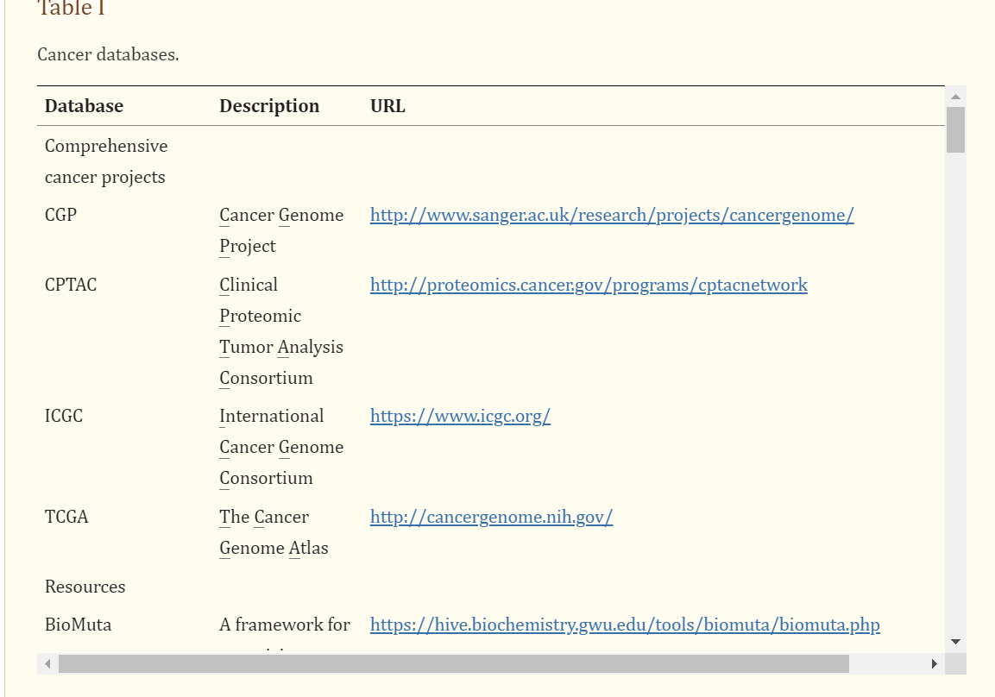
https://www.ncbi.nlm.nih.gov/pmc/articles/PMC4254674/

Slide 13
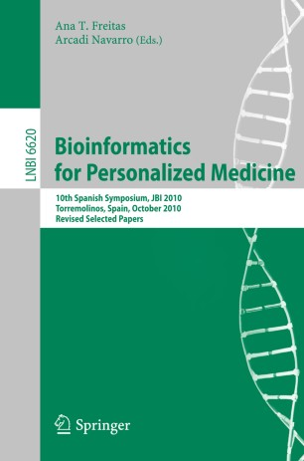
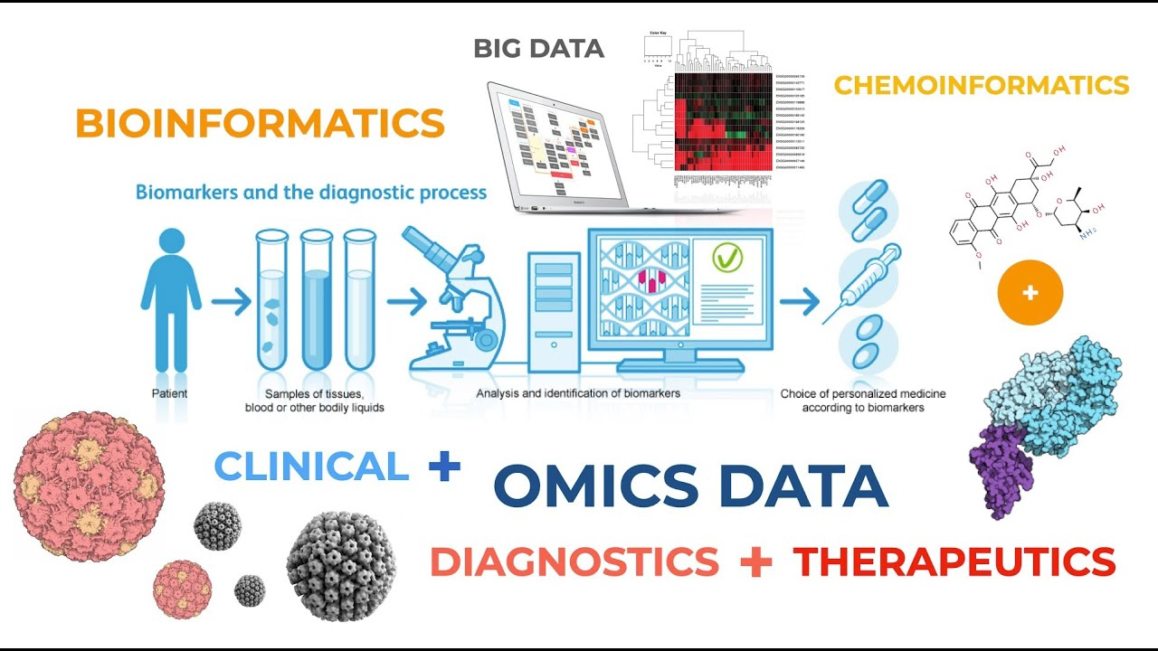
personalized medicine

Slide 14
example of prior probabilities for host factor
A wide range of the aspects of the countries (such as sociological, economic, e.g.) that can have any impact on the survival of the cancer were included as the attributes of a table (1)

Slide 15
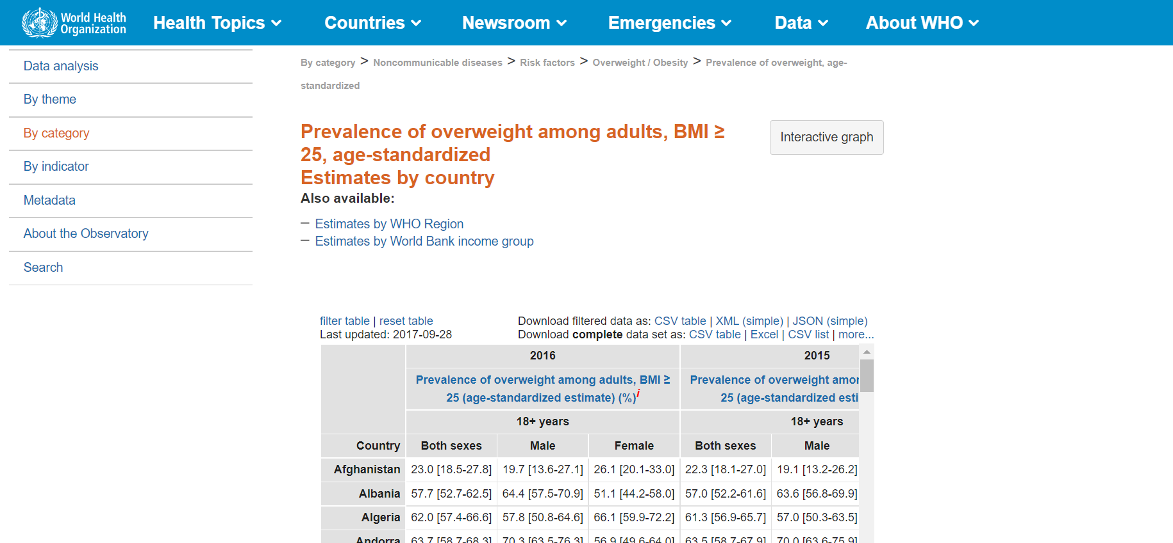

Slide 16
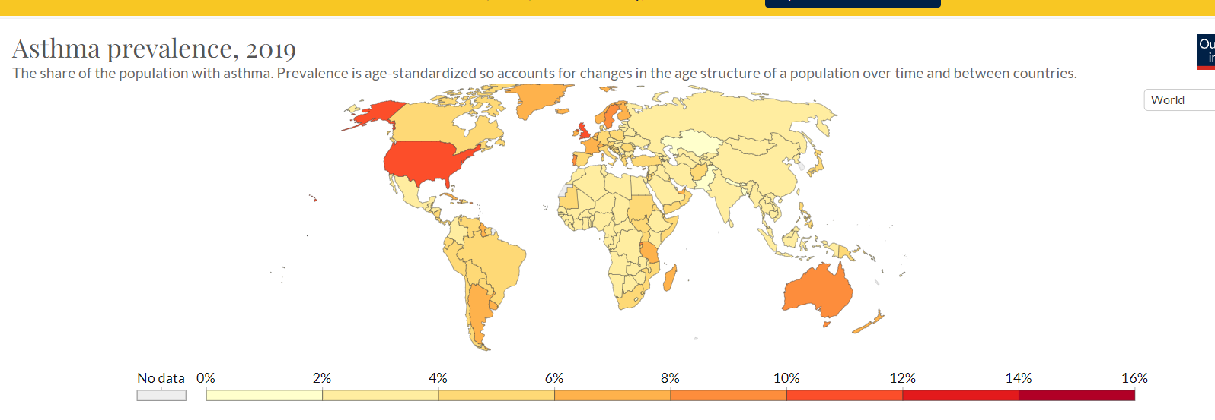

Slide 17
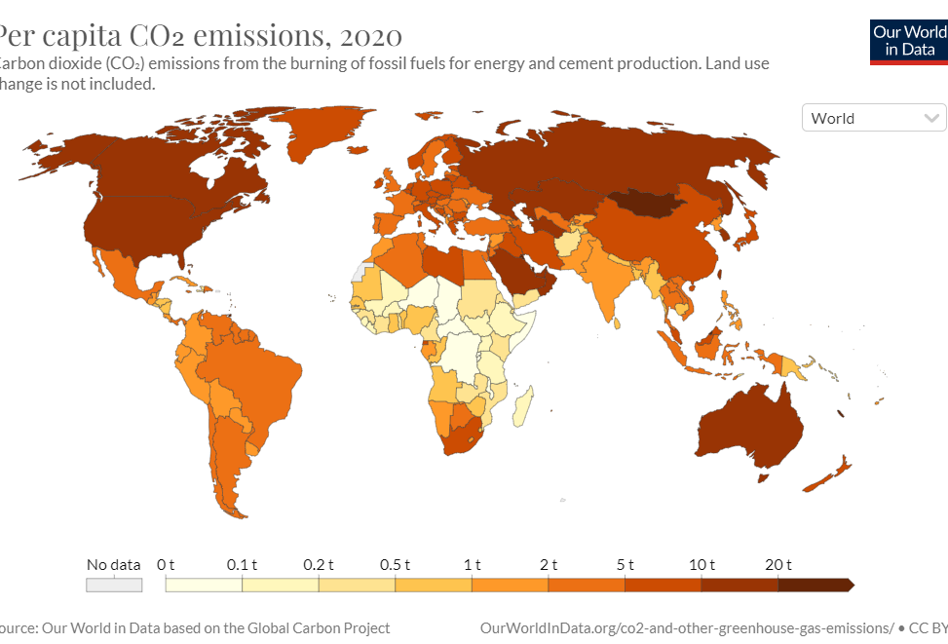

Slide 18
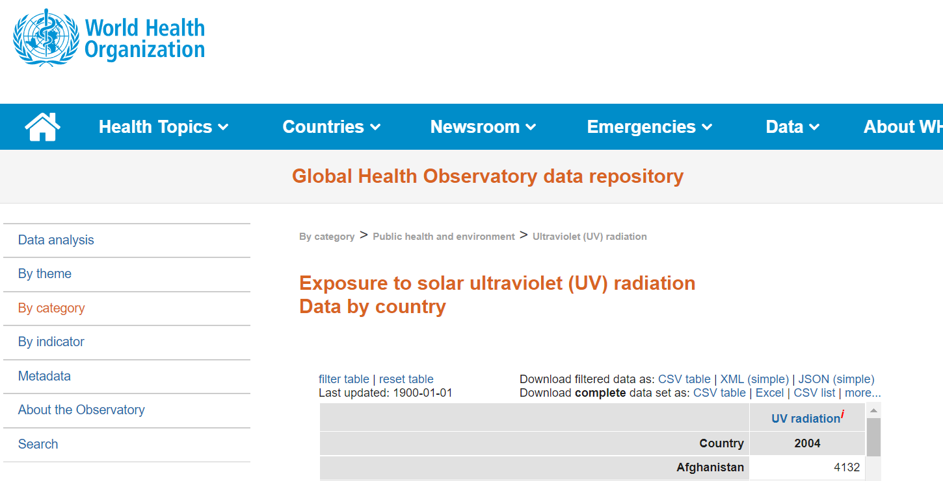

Slide 19
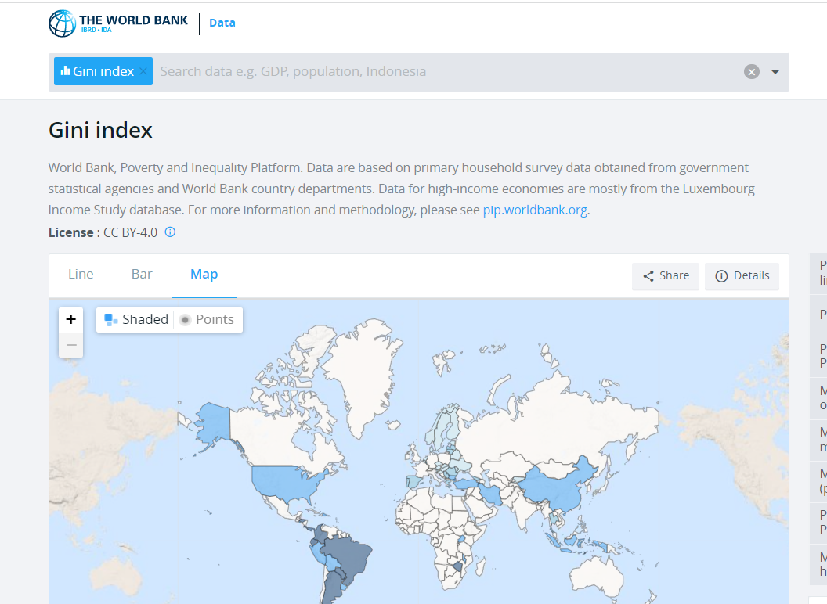

Slide 20
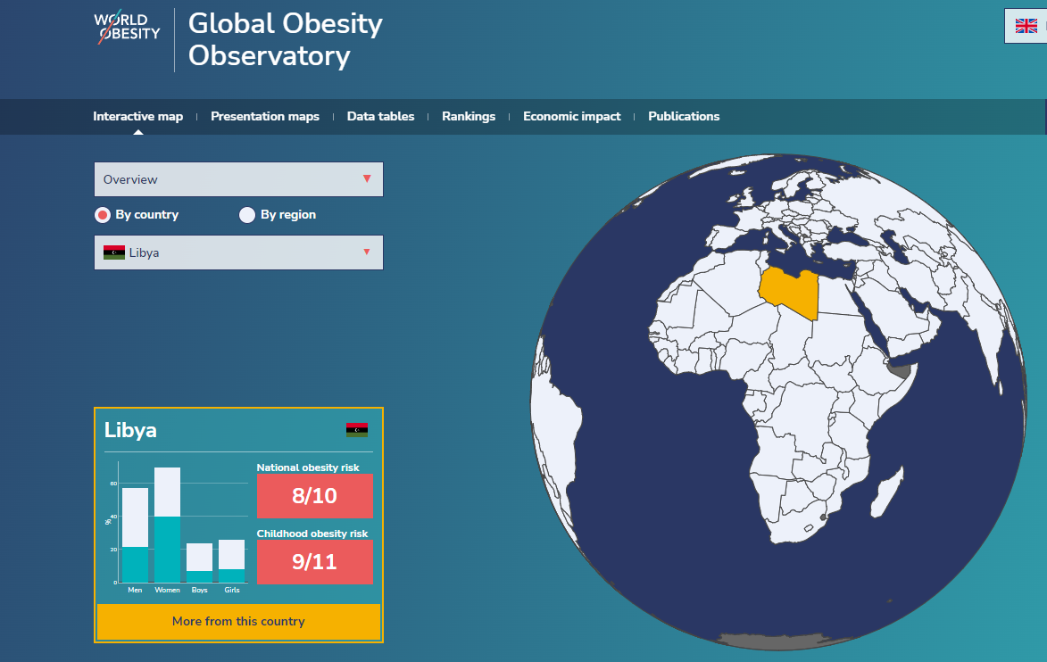

Slide 21
algoritm design #1- do it for detection of host factors as step 1
make regression & correlation with aging & various cancer incidence rates → resulted ones ---> take them as parameters for determining host factors && link them probable cancer types ( with above db examples - including dbs in thesis & develop them as well )
find data for your project!

Slide 22
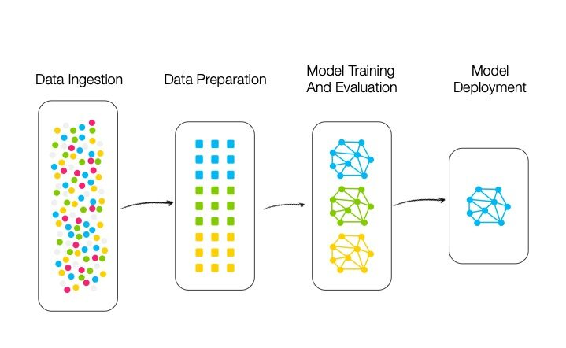

Slide 23
- pipeline development : #microbiome-bu patladı, no enough data set && clinical trials
so theoretical&&complex to apply to the field in a short time

Slide 24
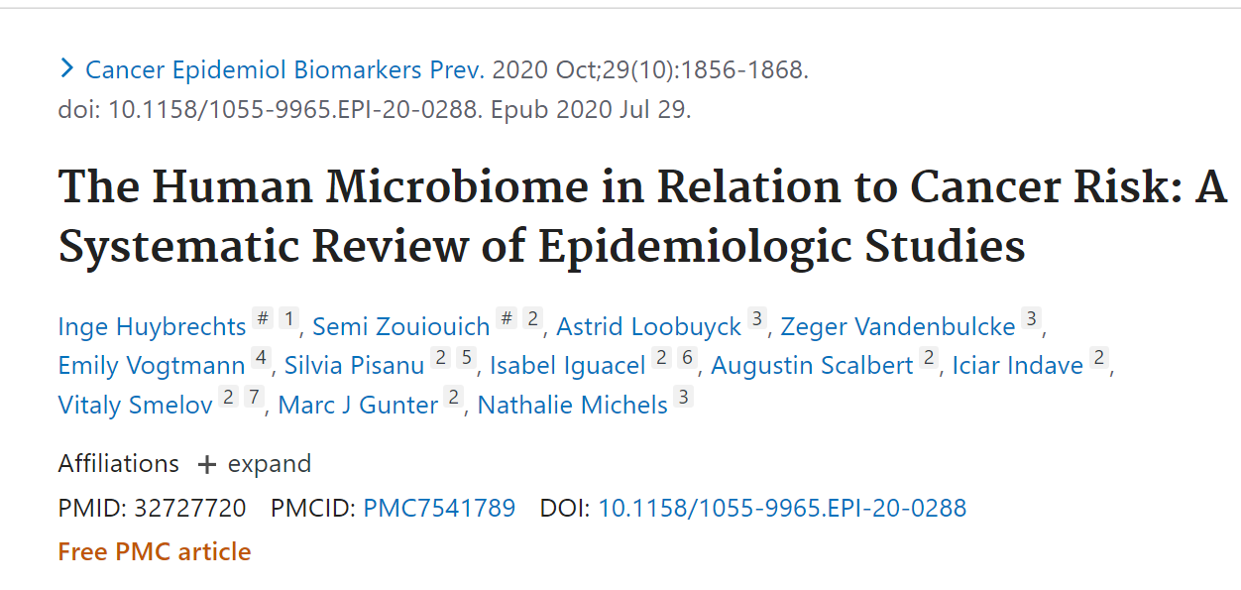
https://pubmed.ncbi.nlm.nih.gov/32727720/#:~:text=Fifty%20studies%20reported%20differences%20in,from%20patients%20with%20colorectal%20cancer.

Slide 25
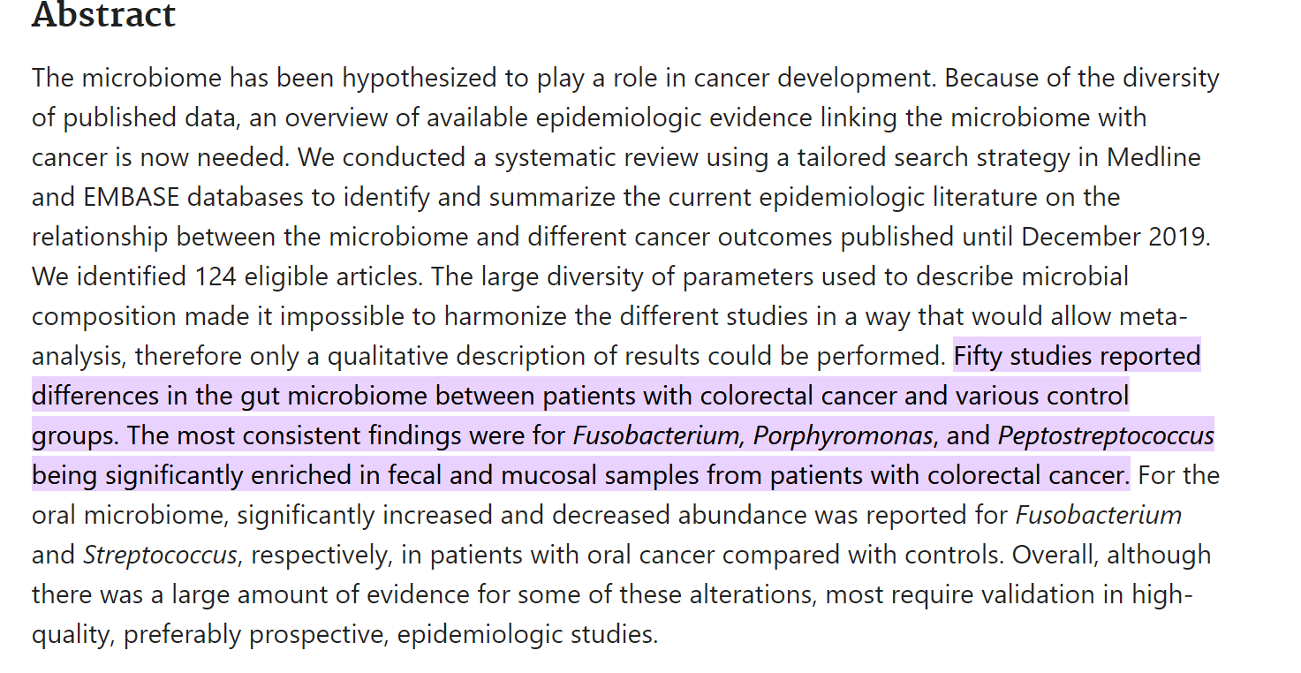

Slide 26
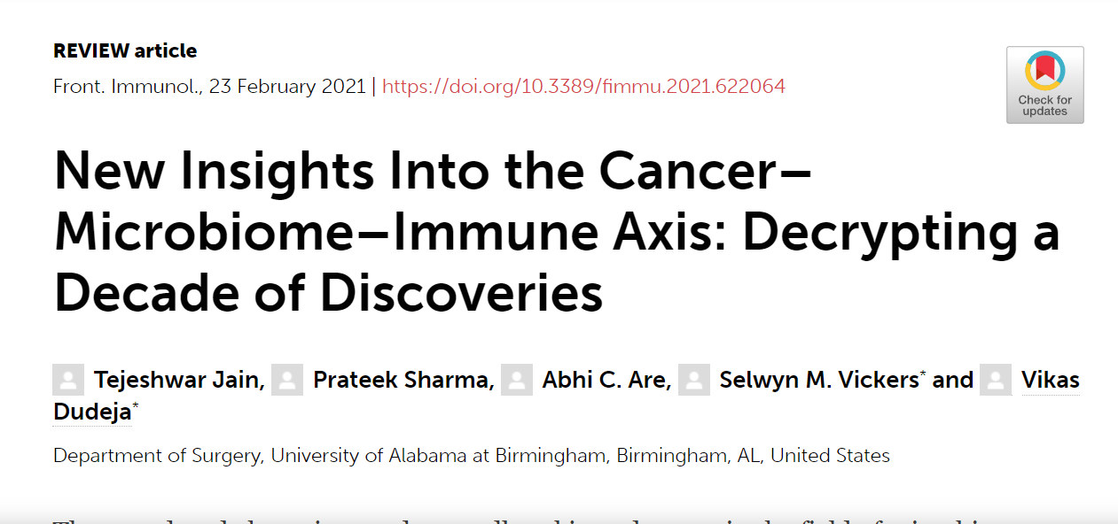
https://www.frontiersin.org/articles/10.3389/fimmu.2021.622064/full

Slide 27
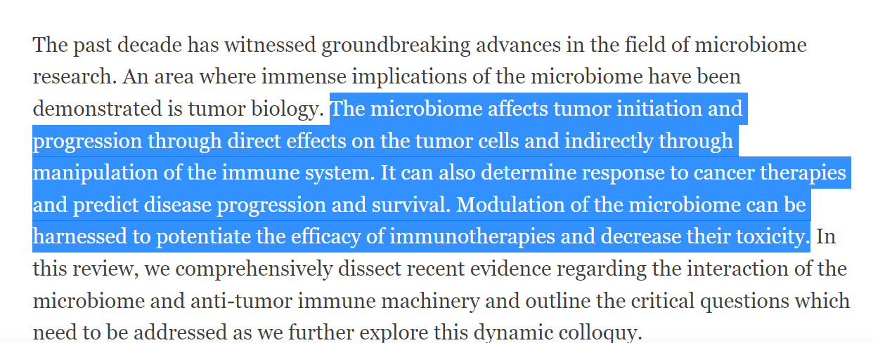

Slide 28
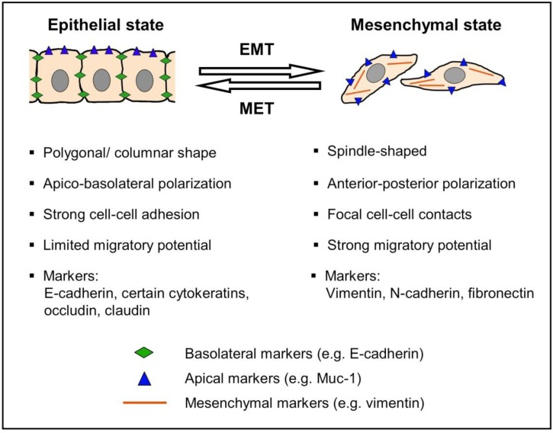
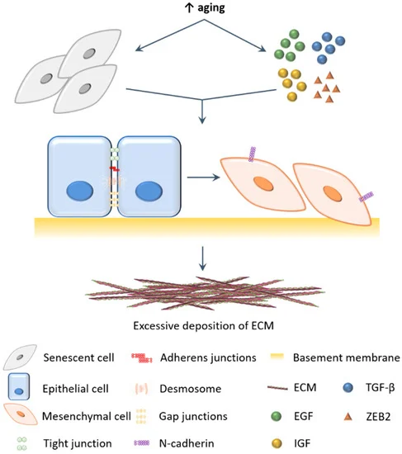
- pipeline development # E-M transition for aging - patlamadı, ama en mantıklısı karar-destek mekanizması oluşturmak

Slide 29
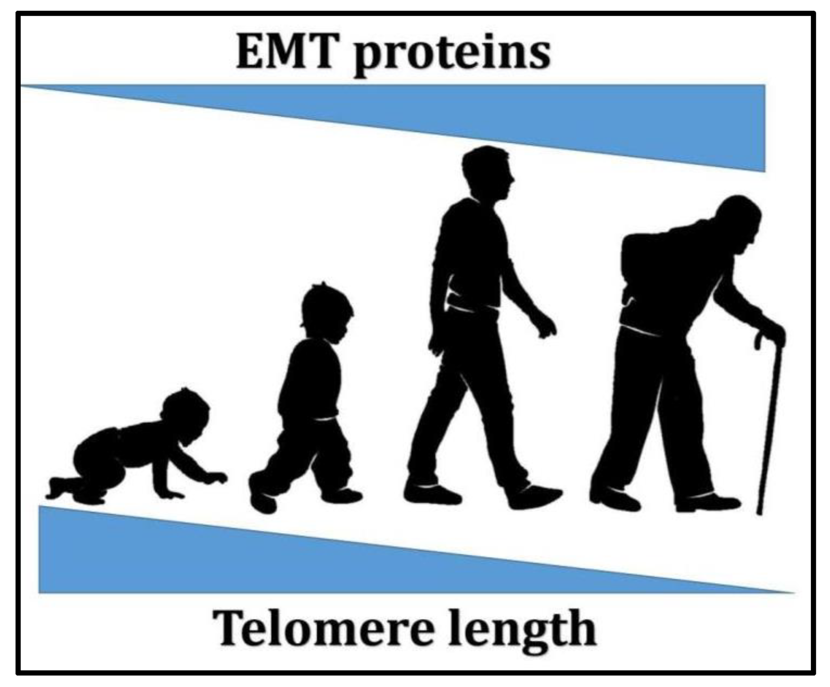

Slide 30
decision-support mechanism : as prob. distribution
sci. information
theoretical inf. for the case
applicable probability distribution for the case-prior inf.
the situation of the patient
out put inf. for the researcher/clinican
from db
from clinic
from db
AI pipeline

Slide 31
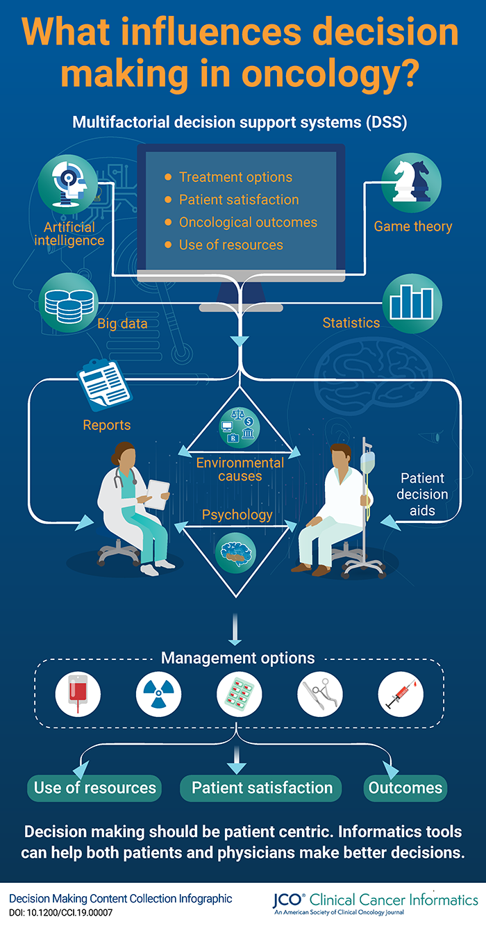

Slide 32
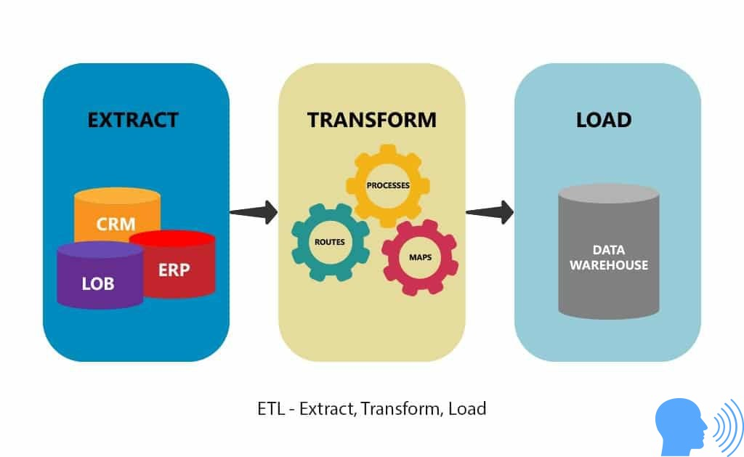

Slide 33
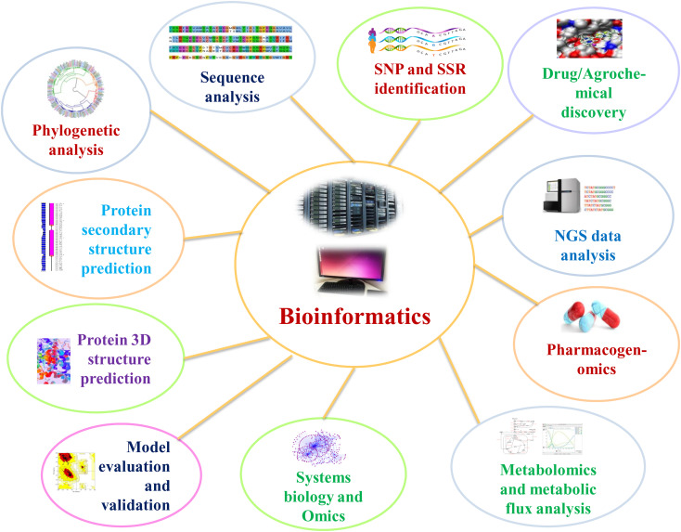
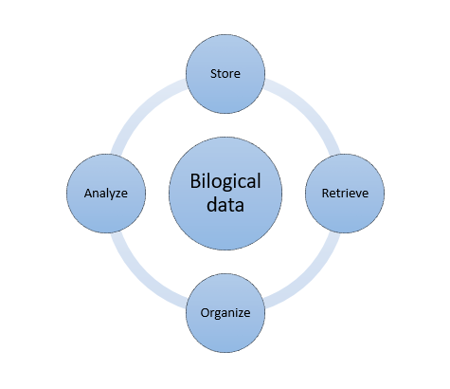
hypothesis development (pre lab/ pre clinics)
analyzing available data from the clinic
meta-analysis of data found in literature + online dbs

Slide 34
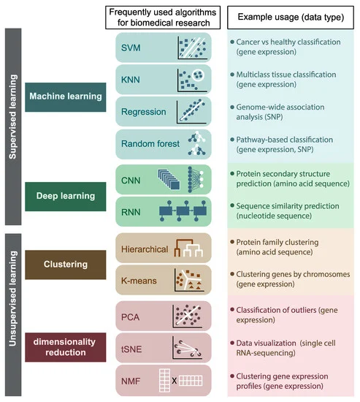
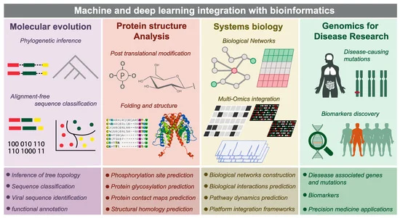
https://www.mdpi.com/1422-0067/22/6/2903/htm
Methods such as Machine learning, Artificial intelligence algorithms, Neural Networks, Bayesian networks are also used in bioinformatics studies and provide advantages in the analysis of biological systems.

Slide 35
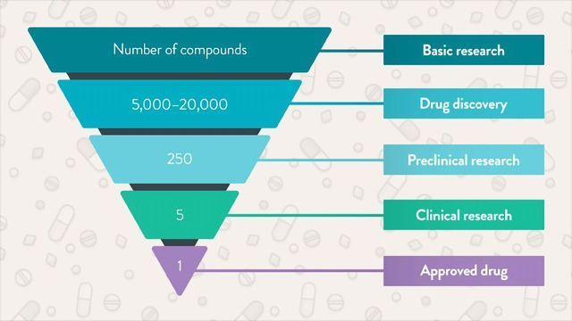
Computational biology enables possible treatments, drugs, processes and steps to be reduced with the help of intensive and high calculations, so the odds can be lowered from 10,000 to 5, as in drug research.

Slide 36
theoretical slides

Slide 37
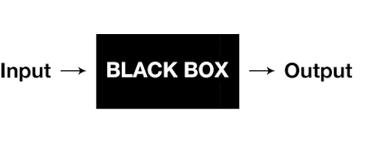
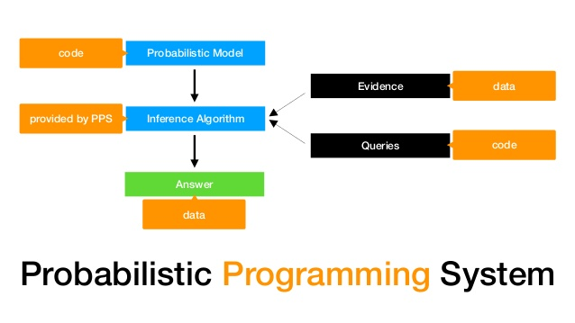
. The schematic representation of the deterministic programming (Google Photos).
The schematic representation of the probabilistic programming system (Blum-Oeste, 2017).

Slide 38
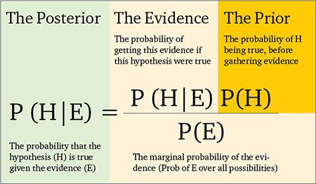
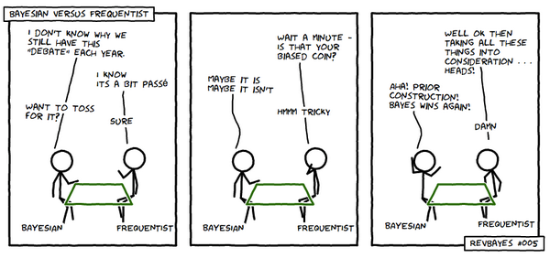

Slide 39
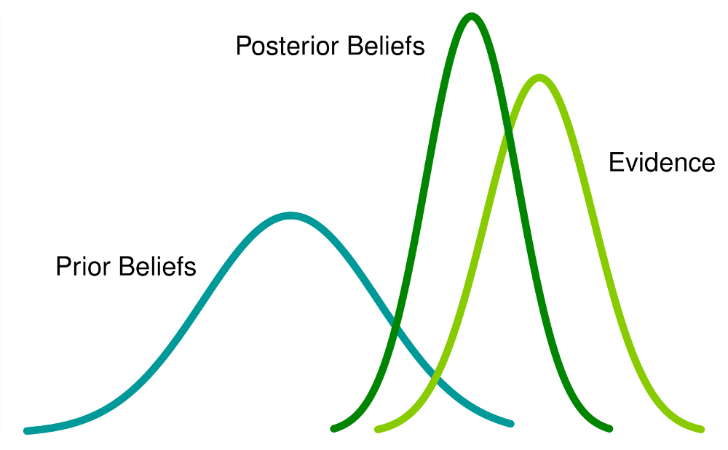

Slide 40
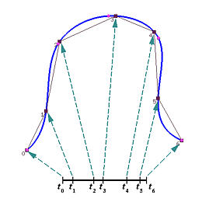
Figure 25. Representation of parameter selection (Parameter Selection Overview, no-date).

Slide 41
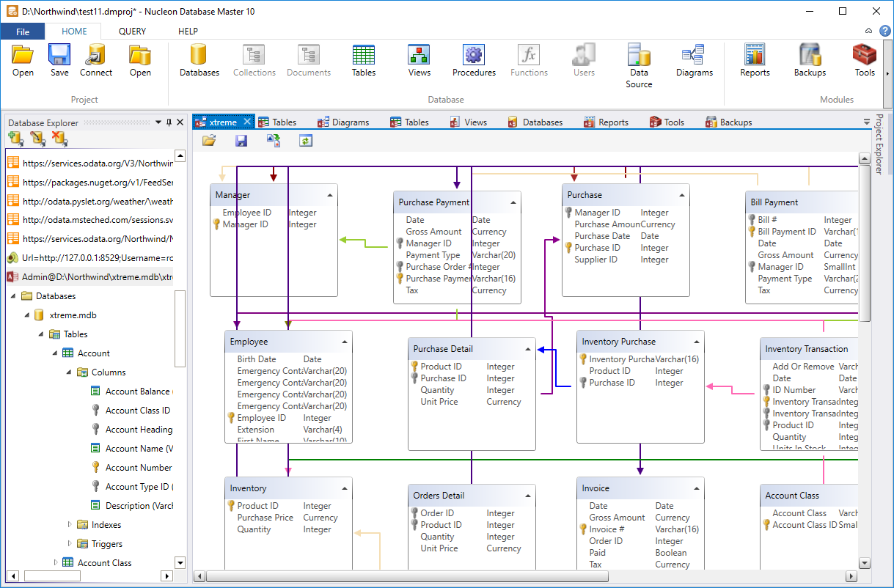
databases allow working by keeping very different data in one hand and switching between data

Slide 42
There are many examples that show the cancer – host factor relations. For example, there is growing evidence that a patient's cancer response to immune check point inhibitors is influenced by host factors such as genetic, metabolic, and immunological factors, as well as the composition of one's gut microbiota (Gunjur et al., 2022). Another example is that, compared with people without obesity or overweight, endometrial cancer is 7 times as likely in people with severe obesity, gastric cardia is 2 times as likely in people with obesity, pancreatic cancer is 1.5 times as likely in people with obesity or overweight, etc. (NIH, n.d.) and it is known that the incidence of cancer increases with increasing age in all types of cancer (National Cancer Institue, n.d.). Cancer cells actively interact with their environment, for example, the increase of T-regulatory cells is a characteristic feature in many cancer types (Beyer & Schultze, 2006) and T-cell infiltraion are associated with solid tumors (Lanitis et al., 2017; Liu & Sun, 2021; Slaney et al., 2014) . Another examples are that, glyco-protein glycosylation is associated with the abnormal glycan expression on cancer cell surfaces (Geng et al., 2012), host microenviroment affects the breast cancer development by altering epithelial-cell–stromal-cell interactions and steroid hormone action (Haslam & Woodward, 2003), glypican-1 (GPC1), a membrane-anchored protein overexpressed in breast and pancreatic cancer (Huang, 2018), dietary patterns of the host affect the coleractal cancer incidence (Garcia-Larsen et al., 2019), biobehavioral signaling pathways influence the cancer progression (Lutgendorf et al., 2010), dynamic mast cell–stromal cell interactions promote growth of pancreatic cancer (Ma et al., 2013), testicular cancer is highest among young men, and then decreases sharply with age (Moger et al., 2004), the contact between cancer cells and macrophages is mediated by chemical compounds (Suzuki, 2017), tumors interact with immune cells, influencing their quantity and activity and allowing tumors to avoid detection and control by the immune system (Talmadge et al., 2007), there is a potential role of exercise in reducing hypoxia and enhancing anti-tumor immunity (Warner & McQuade, 2019). Moreover, recent integrated transcriptomics and metabolomics investigations for breast cancer have found significant evidence that metabolite abundance, and hence metabolic flux, in tumors is strongly linked with transcriptional abundance (Sheraj, 2021). In summary, host factors alter the internal dynamics of the host, modifying the environments through which cancer cells will survive and metastasize (Figure 1 & Figure 2).

